Slide 1
Lesson 2 – Present Perfect
Module 2 – Grammar Study 2

Slide 2
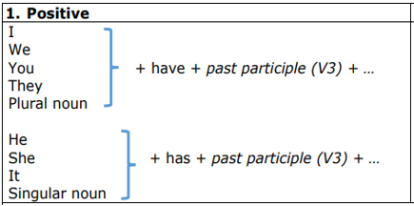

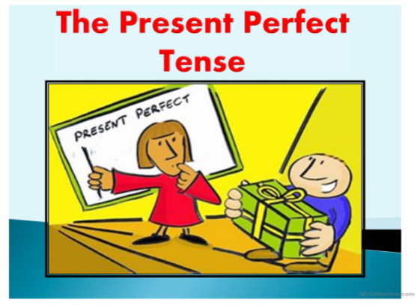
Present Perfect(have/has V3)
Ex: They have done their task accurately.
Ex: She has stayed in Phnom Penh for years
Ex: My students have completed the project on time.

Slide 3
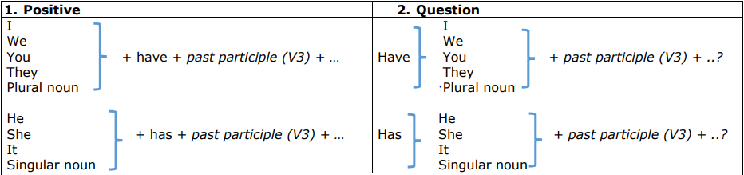

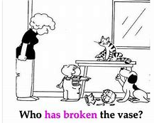
Ex: Have they done their task accurately?
Ex: Has she stayed stayed in Phnom Penh for years?
Ex: Have my students completed the project on time.?

Slide 4
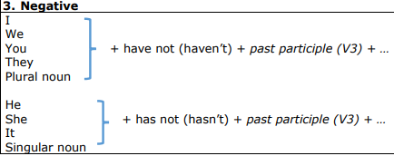

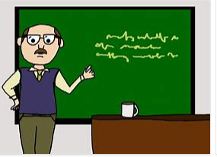
Ex: They have not done their task accurately.
Ex: She has not stayed in Phnom Penh for years
Ex: My students have not completed the project on time.

Slide 5
Usage 1. Indefinite Past សកម្មភាពដែលបាន​បញ្ចប់រួចហើយ។ Ex: I have been to England for three times. Ex: She has already had breakfast. Ex: Has Sokha met Dara yet? 2. Unfinished past សកម្មភាពដែលមិនទន់​បញ្ចប់នៅឡើយ។ Ex: They have studied at PNC for two years. Ex: Narith has not meet Sreypov since 2019.

Slide 6





Thank you !
www.passerellesnumeriques.org

